Slide 1

SEO Audit Report – RachanaRanade.com
Prepared by Insiya Cycle wala

Slide 2
1. Why did I chose this website?
I chose to audit RachanaRanade.com because it’s a well-known finance education platform with high content potential but visible SEO gaps. This made it a great real-world example to apply and showcase my growing SEO skills.
2. What this report contains?
This report covers a complete SEO audit including technical performance, keyword rankings, on-page SEO issues, and detailed improvement recommendations.
3. What tools did I use?
I used SEMrush and Uber-suggest for this audit — to analyze traffic trends, keyword performance, backlinks, and on-page SEO issues.

Slide 3
SEO Performance Overview
Metric | Value
1. Organic Traffic | 99%
2. Paid Traffic | 0.04%
3. Total Backlinks | 8,175 (4,837 no-follow)
4. Domain Authority | 23 (last month it was 24)
5. On-page SEO Score | 70/100
6. Page Load Time | 4.59 s (poor)
7. CLS (Visual Stability) | 0.30 s (poor)

Slide 4
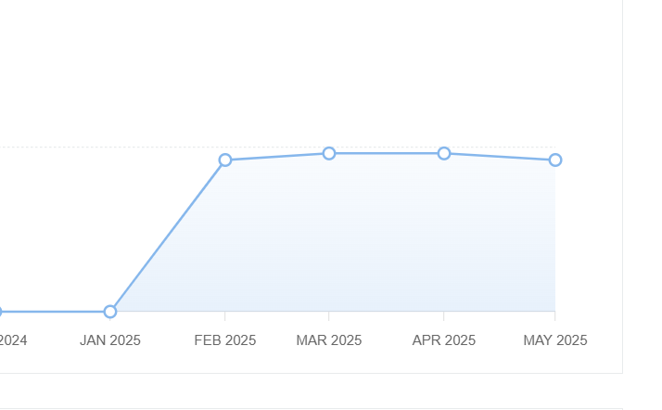
Domain Authority Graph
The domain authority was 24 in March and April but decreased in May to 23

Slide 5
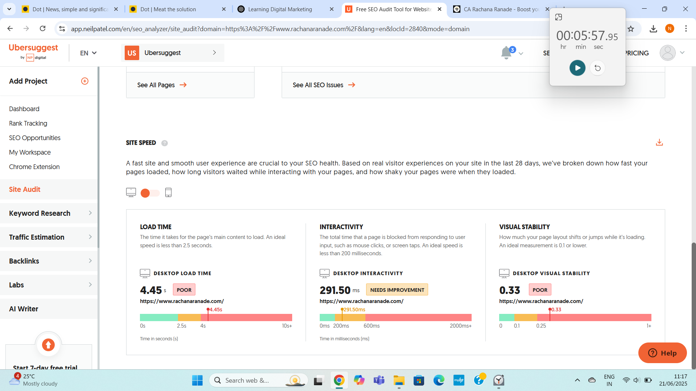
Page Speed Graph
The Page load time is 4.45s which is poor. The interactive time is fine about 291.5ms but the visual stability is poor around 0.33s.

Slide 6
Traffic & Ranking Trends
Month | Organic Traffic
1. January | 0
2. February | 76510
3. March | 71788
4. April | 54405
7. May | 43999

Slide 7
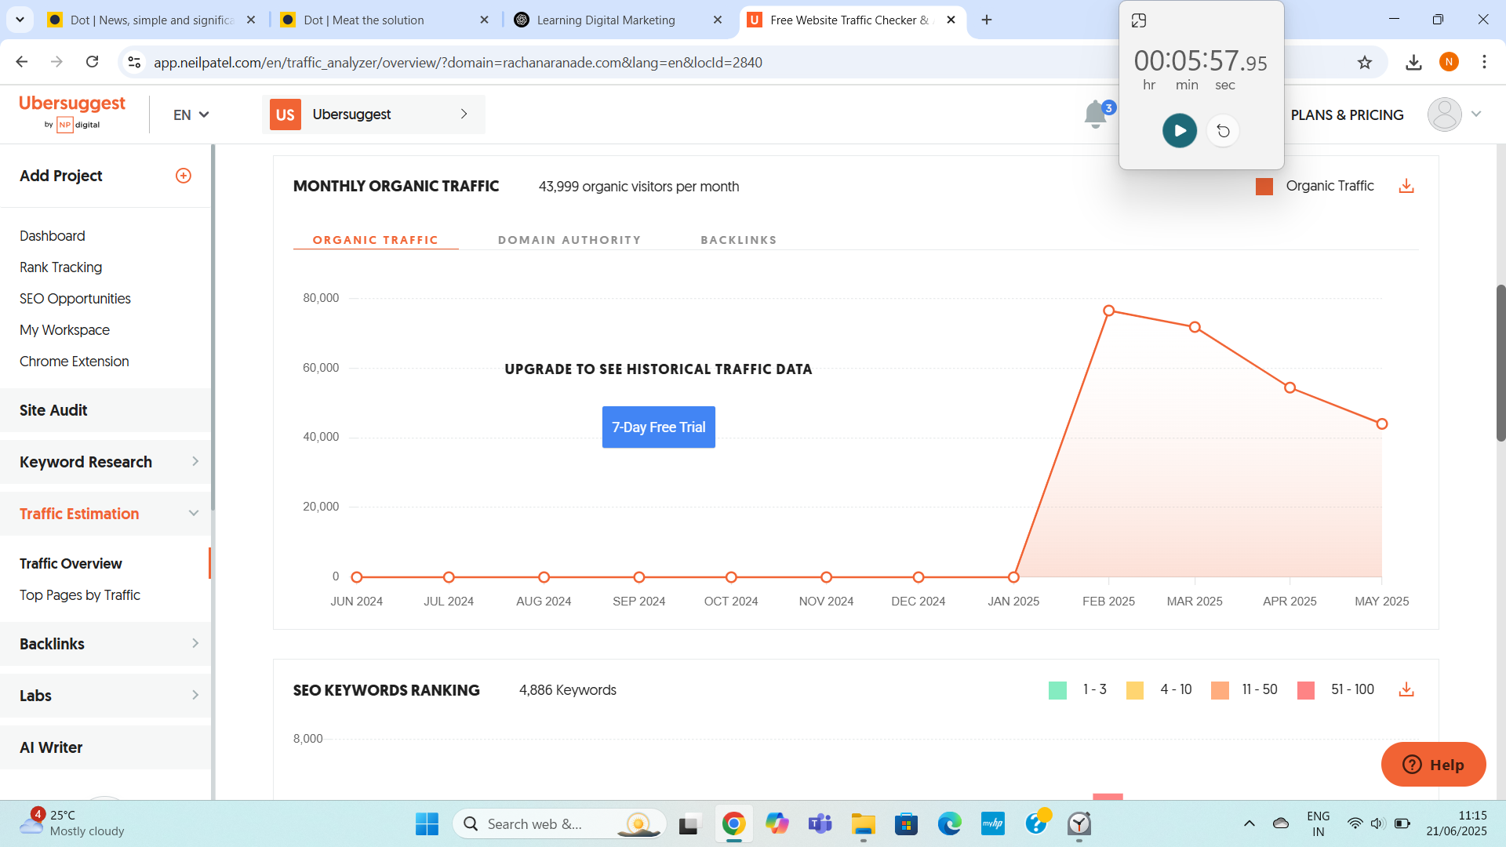
Organic Traffic Graph
The traffic is decreasing because as can see in February the traffic was great around 76000 but as we are descending to May the traffic is decreasing.

Slide 8
Keyword Ranking & Content Performance
Keyword | Rank Position
1. Stock market course | #4
2. stock market courses online with certificate | #8
Top Pages | Monthly Visits
1. Stock Market Course Page | 622
2. Homepage | 198
3. Position Sizing Calculator | 48

Slide 9
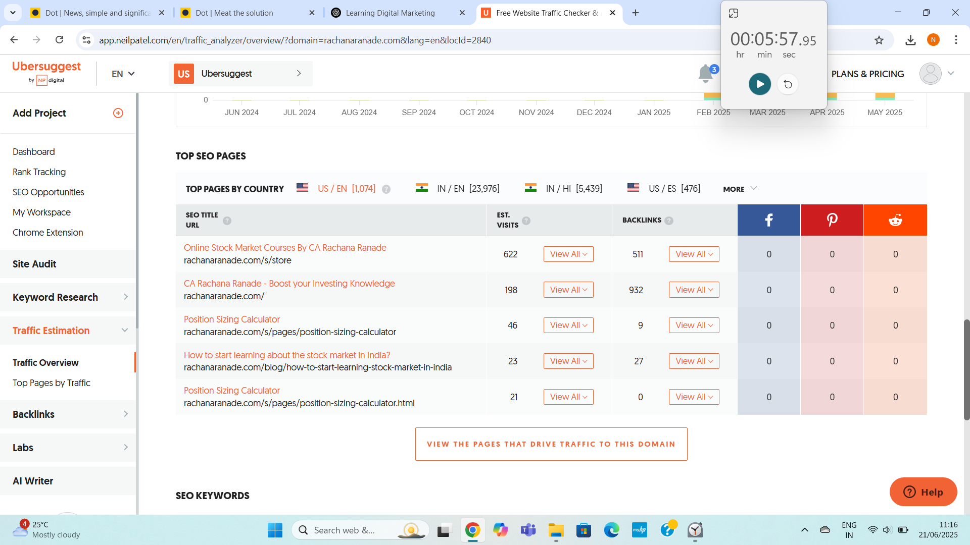

Slide 10
SEO Issues Identified
❌ No sitemap
❌ 27 pages have low word count
❌ 3 pages missing meta titles
❌ 55 pages missing meta descriptions
❌ 94 pages missing H1 tags
❌ Slow loading time: 4.59s
❌ Poor visual stability (CLS): 0.30s

Slide 11
Recommendations (In Detail)
Add a Sitemap: Helps Google crawl all pages. Submit to Google Search Console.
Improve Page Speed: Compress images, enable browser caching, minify CSS & JS.
Add Meta Titles & Descriptions: Every page should have unique, keyword-rich metadata to improve CTR.
Fix H1 Tags: Every page needs 1 H1 tag with the main topic/keyword.
Update Thin Content: Pages <300 words should be expanded with valuable content.
Leverage High-Ranking Keywords: Push “stock market course” to Top 3 using internal linking, backlinks, and on-page SEO.

